Slide 1


K.RAMAKRISHNAN COLLEGE OF TECHNOLOGY
(AUTONOMOUS), TRICHY
FontSense AI: A Noise-Resistant Multilingual Font Recognition System Using Domain Adaptation
PRESENTED BY GUIDED BY
BHARANI G - 2403811724321013 Ms. ADEEBA AAISHA F
BHAVADHARANI S - 2403811724322014 TA /AIDS
CHANDRU A - 2403811724321015
CHANDRU R - 2403811724321016

Slide 2
PRESENTATION OVERVIEW
Abstract
Objective
Architecture diagram
Literature survey
Research methodology
Existing system
Proposed system
Conclusion
Future enhancement

Slide 3
ABSTRACT
Font recognition is important in document analysis, OCR, digital publishing, and translation systems. Existing font recognition systems perform well only on clean, high-quality but struggle with noisy, blurred, low-resolution, and unevenly illuminated images. FontSense AI introduces a multilingual dataset containing 14 languages and 8 font styles for each language. The system combines Data Augmentation and Domain Adaptation to improve recognition accuracy in real-world conditions.

Slide 4
OBJECTIVE
    Develop a robust font recognition system for noisy environments.
Improve recognition accuracy under blur, shadows, and lighting variations.
Support multilingual font recognition across 15 different languages.
Apply domain adaptation to reduce differences between training and real-world data.
Build a practical solution that works with both color and grayscale images.

Slide 5
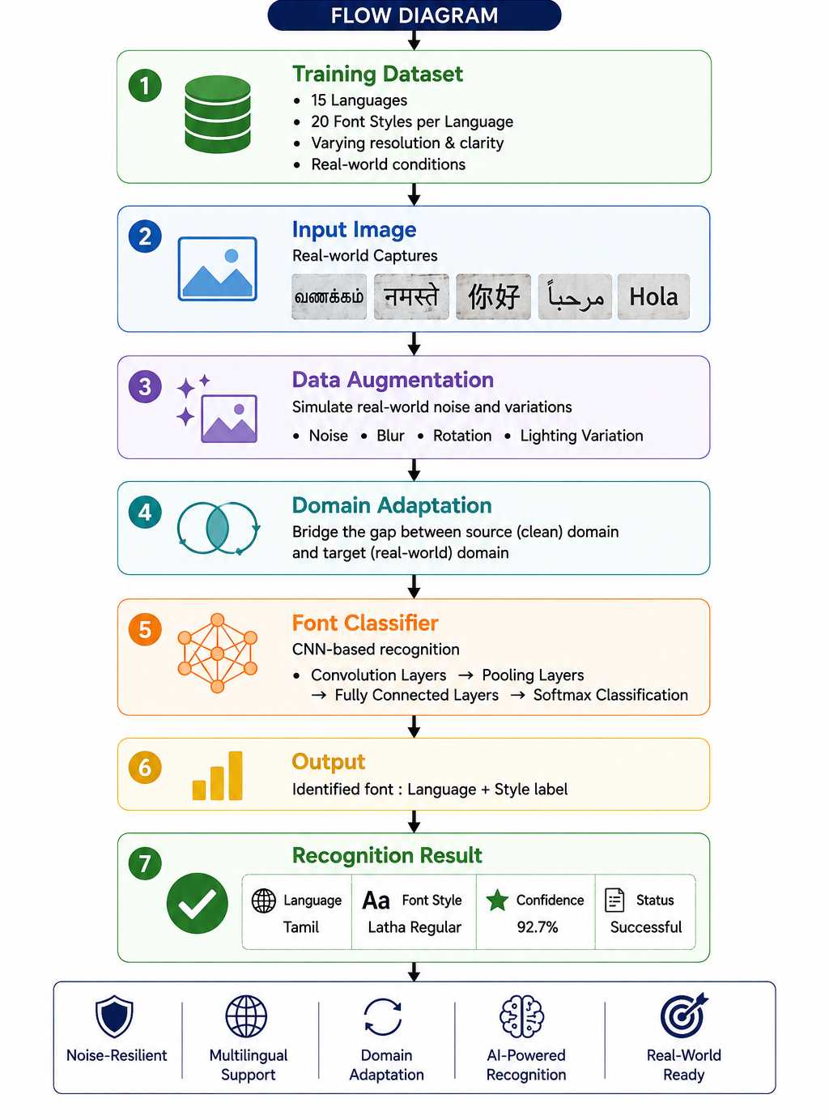
ARCHITECTURE DIAGRAM

Slide 6
LITERATURE SURVEY
FontSense_AI_Literature_Survey_2024_2026.xlsx

Slide 7
RESEARCH METHODOLOGY
1. Dataset Collection
I. Collect font images from 15 languages.
II. Include 20 font styles per language.
2. Preprocessing
I. Resize and normalize input images.
II. Prepare images for model training.
3. Data Augmentation
I. Remove noise, blur, and rotation.
II. Simulate lighting and real-world variations.

Slide 8
RESEARCH METHODOLOGY
3. Domain Adaptation
I. Use clean images as the source domain.
II. Adapt the model to noisy real-world target images.
5. Feature Extraction
I. Use CNN layers to extract font features.
II. Learn patterns such as strokes and character shapes.
6. Classification
I. Classify the language and font style.
II. Use a Softmax classifier for prediction.

Slide 9
RESEARCH METHODOLOGY
7. Evaluation
I. Measure accuracy, precision, recall, and F1-score.
II. Test performance on clean and noisy images.

Slide 10
EXISTING SYSTEM
Supports only 4 languages
Uses 10 font styles per language
Works only with grayscale images , Requires high-resolution images.
Cannot process color images effectively.
Sensitive to blur and image noise.
Poor performance under real-world conditions.

Slide 11
PROPOSED SYSTEM
Supports 15 different languages
Includes 20 font styles per language
Accepts both color and grayscale images
Uses a real-world multilingual dataset

Slide 12
CONCLUSION
      The system performs effectively under noisy and low-quality imaging conditions.
Data augmentation improves model robustness.
Domain adaptation bridges the gap between training and real-world data.
The proposed framework offers accurate and practical font recognition for diverse environments.
Notes:
12

Slide 13
FUTURE ENHANCEMENT
Real-time font recognition using mobile cameras.
Video-based font and language detection.
Support for ancient and endangered languages.
Larger multilingual datasets with additional font styles.
Faster deployment on mobile and edge devices.

Slide 14
THANK YOU

